Slide 1
Advanced higher Graphic communication
Technical Graphics - Creators and Users

Slide 2
introduction
In this lesson you will learn about the different Technical Graphic Creators and users and the type of graphics they commonly use.
Design Engineers
Manufacturing Engineers
Assembly Technician
Test Engineer
Model makers

Slide 3
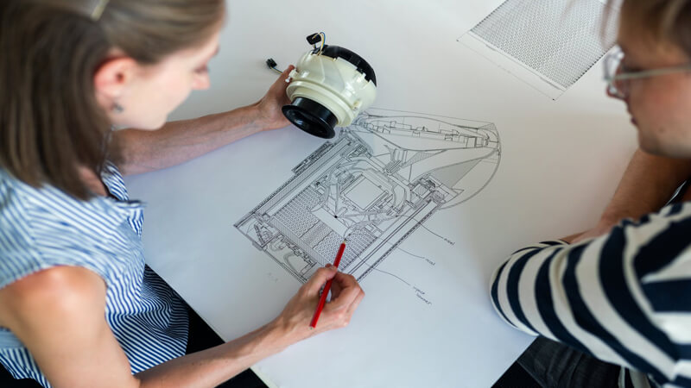
Design Engineers
The Design Engineer works on the project at the beginning and at the end. It is their responsibility to fully understand what the client expects of them. They need to; be fully aware of the time frame by which the client wants the product to be completed, know the specification of the product and be able to produce concept sketches to help the client visualise what the engineer believes the finished product could look like.
Their initial drawings would generally be sketches drawn up after a client meeting these could be produced manually or electronically. Once approved and with the consent of the client the Design Engineer would then have the authorisation to produce the production drawings.
The drawings involved in the Production drawings are: assembled orthographic and pictorials, component orthographic and pictorial, exploded, detailed views, sectional views and any range of movements. A parts list would be expected along with a bill of materials and even a Sequence of Operations to aid the assembly. The drawings would have to produced to the standard for the country requiring them for example BSI in the UK or ANSI in the USA.
These drawings would be approved and authorised before being passed on to the Manufacturing Engineer. The Design Engineer then reviews the finished product once it has been fully manufactured and assembled to ensure the product conforms to the client’s specification.

Slide 4
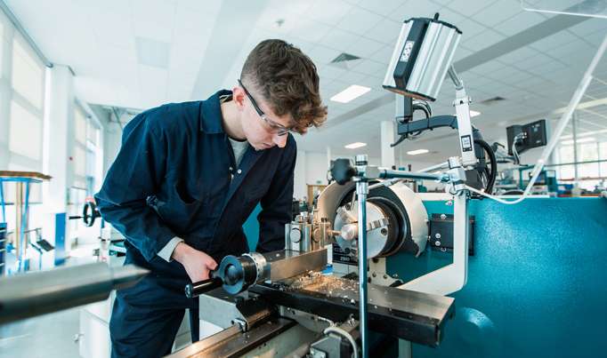
Manufacturing Engineer
The Manufacturing Engineer makes the physical product components. They are generally experienced in the machinery that they use to manufacture. However some can be qualified in a range of manufacturing areas such as; turning, milling and welding. The Manufacturing Engineer must take a piece of raw material and create a functioning component using the production drawings.
The production drawings they would use are; component orthographic and pictorial drawing. On those drawings there would need to be sufficient dimensions and tolerances and technical detail (sectional views, exploded views etc) to allow the Manufacturing Engineer to have a clear understanding of the components that they are producing.
The Manufacturing Engineer would have to ensure accuracy of production and always work to the tolerance stated on the production drawings. He will manage the manufacturing process to ensure a high quality is achieved and do so within the agreed time frame. In doing this he will ensure the components will work and assemble correctly and pass inspection and quality assurance procedures in place and managed by the Conformity Engineer. Meeting agreed time scales will ensure that no financial loss is accrued during the manufacturing process.

Slide 5
Assembly Technician
The Assembly Technician plans and organises the assembly of the components that the Manufacturing Engineer(s) produce.
Prior to them assembling the product the components must be quality assured and inspected by a Conformity Engineer. Only once the batch of components pass inspection and are approved for use in this product can the Assembly Technician begin to assemble the product. Their main role is to ensure that all of the components are assembled in the product and that they fit securely to enable the product to function correctly.
In order for the Assembly Technician to assemble the product they must refer to the production drawings. They would be focussed on the assembled & exploded pictorial drawings, sections and assembly notes, parts list and sequence of operations for the main assembly and visualisation of the final product. However, they would also refer to the orthographic and in particular sectional/detailed views to show the location and placement of any internal components.
The product must be assembled correctly and to the exact requirements specified on the production drawings to ensure it functions correctly. It is then put through the next stage of the production process which is product testing.

Slide 6
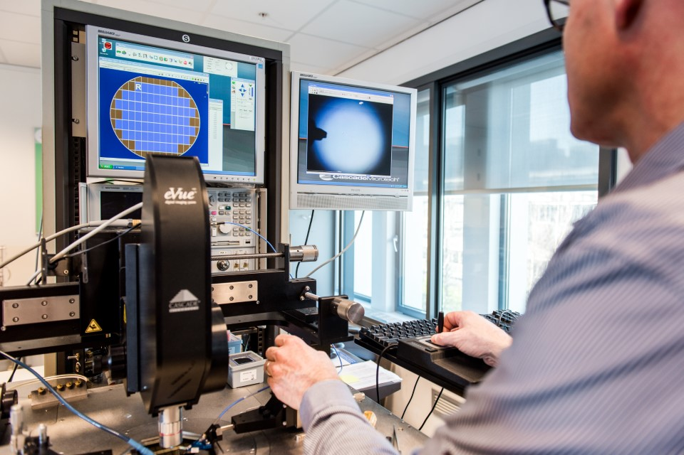
Test Engineer
Test Engineers are responsible for the quality of a product. They perform tests on a product to ensure that it will work properly under certain conditions and meet the product specifications by simulating the load and abuse that real users will place on the product.
Test Engineers have to be able to read detailed technical drawings and use measuring equipment to ensure that the product complies with the dimensions and tolerances on the drawings.
Test Engineers are also likely to use Finite Elements Analysis (FEA) and Computational Fluid Dynamics (CFD) software to test structures, products and buildings.

Slide 7
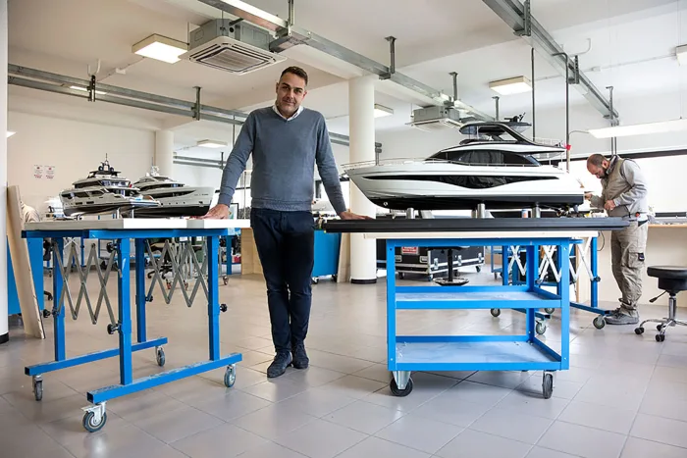
Model makers
Model makers make three-dimensional (3D), physical scale models of products.
Model makers work closely with the client or designer, either independently or as part of a team. They use freehand drawing skills or computer-aided design (CAD) to illustrate initial ideas, which may need to be amended as a result of further consultation before a detailed final model is produced.
They will need to be able to read detailed engineering drawings, showing dimensions, assembly details etc. to allow accurate manufacture of a model.
A model maker is now likely to make physical model from a 3D CAD model using rapid prototyping technology.

